Slide 1

LAB 10
Shor’s Algorithm Part - 1

Slide 2
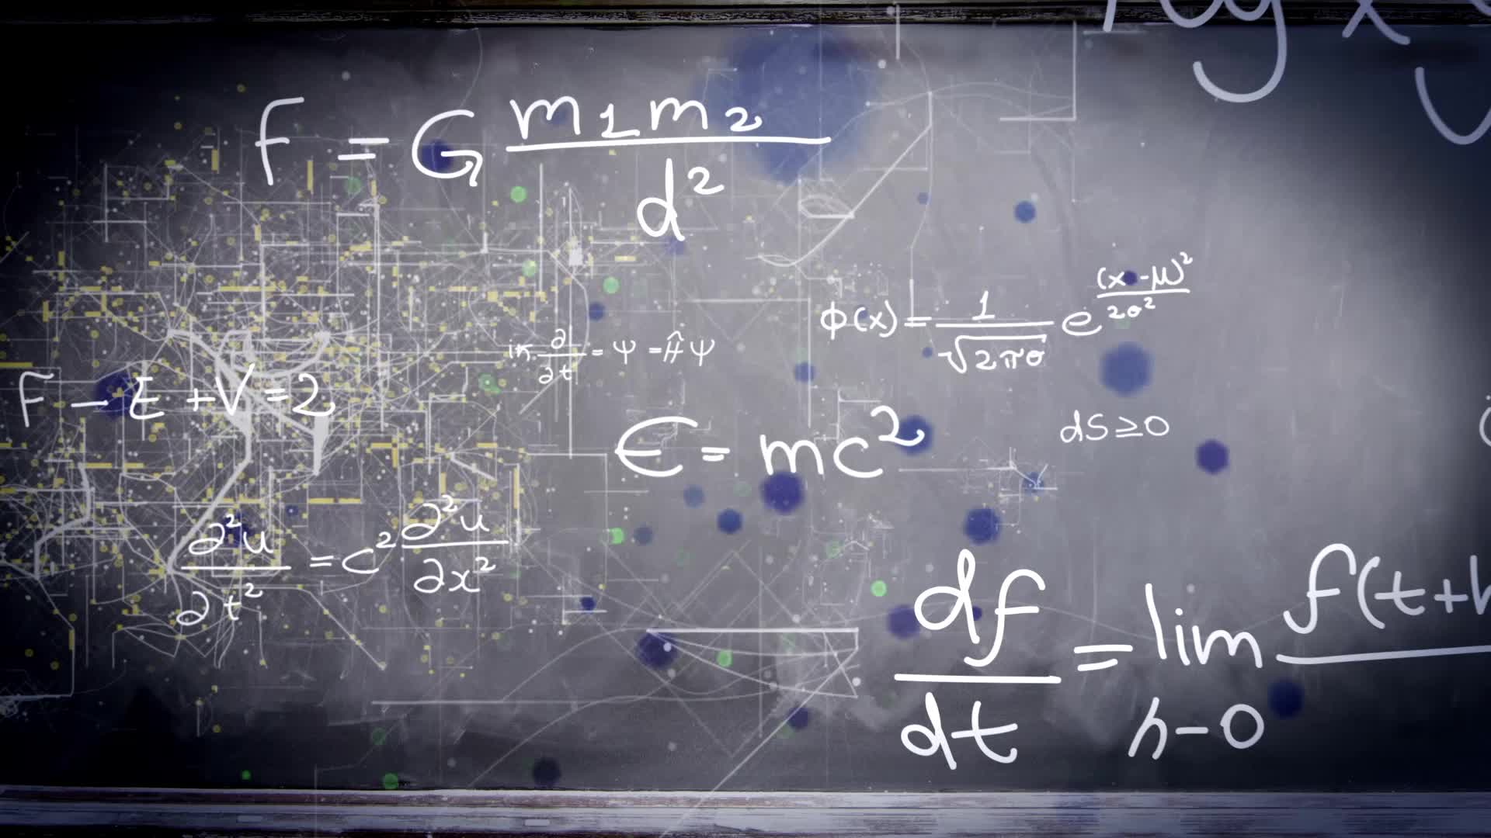
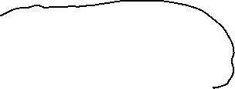

Components of lab:
Revise of Quantum Phase Estimation
Accuracy of Approximation
Shor’s Algorithm Part – 1
Theory Revise
RSA Encryption
Order finding problem
Modulo Algebra
Overview of Shor’s Algorithm

Slide 3









































Slide 4


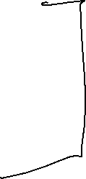

























Slide 5



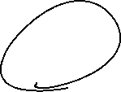


















Slide 6










Lemma 9.1: Given a composite number N and x, s.t. x is a nontrivial square root of 1 over N (that is, x2 ≡ 1(mod N), and neither x ≡ 1(mod N) nor x ≡ −1(mod N)), we can efficiently compute a nontrivial factor of N.
Lemma 9.2: Let p be an odd prime and let x be uniformly random element s.t. 0 ≤ x < p. Then ord(x) is even with probability at least one-half
Lemma 9.3: Let N = p×q, p,q ∈ P is composite odd number and x is taken uniformly at random from 0..N −1. If gcd(x,N) = 1 then with probability at least 3 8 ord(x) = r is even and x r 2 6= ±1(mod N).

Slide 7


